Slide 1
Lecture 9: Introduction to Computer Programming Course - CS1010
DEPARTMENT OF COMPUTER SCIENCE | 10/08/2019

Slide 2
Announcements
Exam 1 grades are

Slide 3
Goals for today
Tuples
Images

Slide 4
Object Types
Name | Type (representation) | Example
Integers | int | Whole Numbers: 1, 5 , 7500
Floating Point | float | Decimal: 2.3, 4.6, 23.15
Strings | str | Ordered sequence of characters: “hello” “Sam” “2000”
Tuples | tuple | Ordered immutable sequence of objects: (100,”Hello”, 20.5)

Slide 5
Tuple Data Type
A Tuple is a collection of Python objects separated by commas.
In a few ways a tuple is similar to a string in terms of indexing and slicing.
A tuple is immutable i.e. once an element is inside a tuple it cannot be re-assigned.
You can change the entire tuple but not a part of it.
We use Parenthesis to denote Tuples:
E.g. (1,2,3)

Slide 6
What are Tuples used for?
Mostly for multiple assignment
Write functions that return multiple values
Let’s check in python.

Slide 7
Modules – Modular Programming
Process of breaking a large programming problem into separate, smaller, more manageable subtasks or modules.
Advantages to modularizing code:
Simplicity: Instead of focusing on an entire problem, a module typically focuses on one relatively small portion of the problem.
Maintainability: There is a less chance that changes in one module will impact other parts of the program.
Reusability: The same module can be used by various programs.
Scoping: Modules typically define a separate namespace, which helps avoid confusion between identifiers in different areas of a program.

Slide 8
Modules
Collection of Python objects stored in one place/file.
Syntax
import module_name
module_name.function(arguments)
Problem: We need to calculate the area of a circle, cone, cylinder and sphere.
Need to use these calculations multiple times

Slide 9
Packages: PiPy and Pip Install
PiPy is a Python repository for open source third party Python packages.
We have used libraries that are built-in with Python.
We can use the libraries that are shared on PiPy (called packages)
We need to use pip install command (at the command line) to install these packages
Go to Anaconda prompt and type pip install <package_name>
Alternately: Do conda install pillow

Slide 10
Example
There are packages already created for almost all use cases you can think of in Python.
A quick google search will lead you to the PiPy page for the package or the package documentation.
Type python package for <function you want>
For example for : Python package for excel you will find this link:
http://www.python-excel.org/
Windows user can use command prompt.
Mac Users use Terminal Window

Slide 11
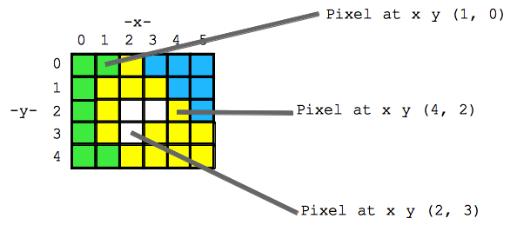
Images
The Python Imaging Library is PIL.
It provides the python interpreter with image editing capabilities.
An image is a two-dimensional matrix of pixel values.

Slide 12
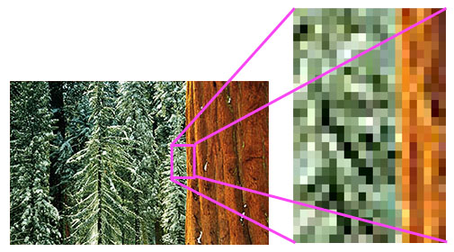
Pixel Representation

Slide 13
Images
Pixel values stored in an image can be:
RGB — a “three-tuple” consisting of the red, green, and blue values, all non-negative integers.
L — a single “gray-scale” integer value representing the brightness of each pixel.

Slide 14
Images- Basic Colors
Color | (red, green, blue) value
Black | (0, 0, 0)
Red | (255, 0, 0)
Green | (0, 255, 0)
Blue | (0, 0, 255)
White | (255, 255, 255)
Light Gray | (122, 122, 122)

Slide 15
Operations with Images
Using the Image Module we can:
Open an Image from a path
Save an Image
Retrieve Size of the Image
Rotate an Image
Crop Image
Resize Image
From ‘Images’ folder on Submitty download the 3 Images and save in your working directory.

Slide 16
More Operations
Changing the image:
The functions we used so far did not change the actual object/image.
There are methods that change the object:
Copy
Paste

Slide 17
Problem 1
Write a function called add_tuples that takes three tuples, each with two values, and returns a single tuple with two values containing the sum of the values in the tuples.
Test cases
add_tuples( (1,4), (8,3), (14,0) ) : (23, 7)
add_tuples( (3,2), (11,1), (-2,6) ): (12, 9)

Slide 18
Problem 2
Get an image (your own or from google) and do the following:
Read the image into python
Crop it (Based on the size of the Image crop half – for both x and y co-ordinates)
Covert it to grayscale
Save it in your working folder.

Slide 19
Next Lecture
Exam 1

